Slide 1
Single-Cell Stranded Total RNA Sequencing
®

Slide 2
Agenda
Fluidigm technology overview
C1 full-length mRNA-seq chemistry complements droplet approaches.
C1 supports a flexible array of applications.
Total RNA-Seq on C1 enables analysis of nonpoly(A) and noncoding RNA.

Slide 3
Technology overview

Slide 4
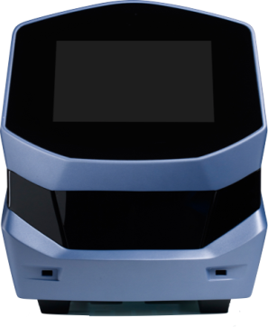
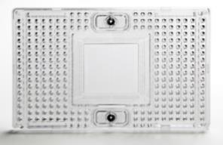
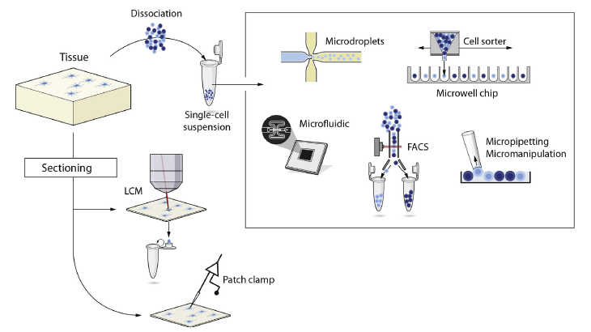
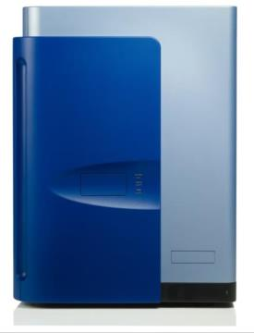
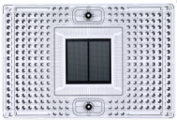
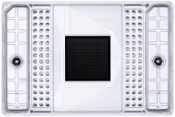
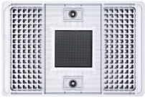
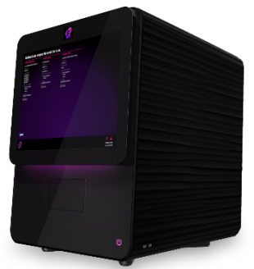
Microfluidics To capture, verify, perturb, and process individual cells
C1™ system
Biomark™ HD
Polaris™
Modified from Hedlund and Deng,
Molecular Aspects of Medicine (2017)

Slide 5
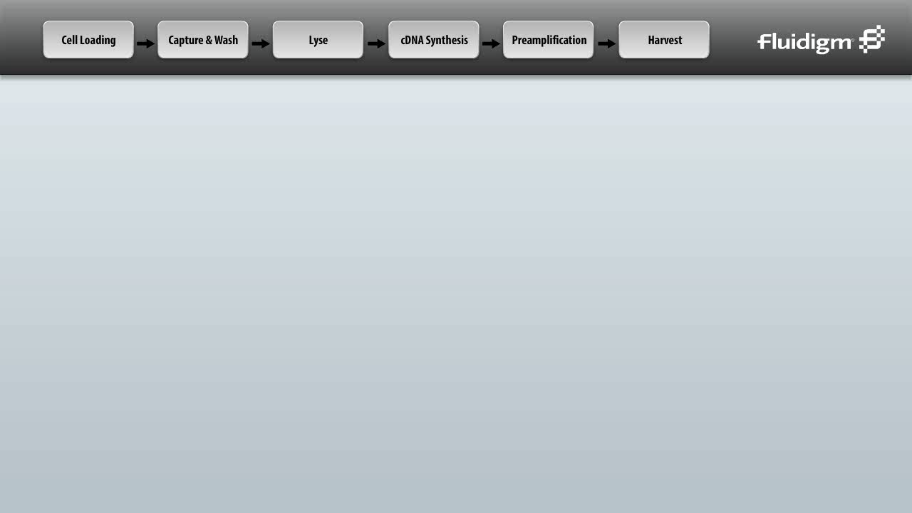
Microfluidics for single-cell genomics C1 system with integrated fluidic circuits (IFCs)

Slide 6
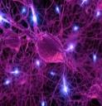
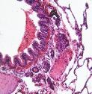
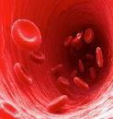


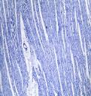
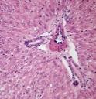


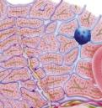

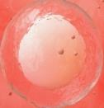
Creating a cell atlas Single-cell genomic technology is required
The only way to identify and understand all cells in a tissue
Three cell-based approaches:
Classification
Characterization
Contextual
Notes:
There are 37 trillion cells in the body, but only ~250 known cell types. Large scale single-cell studies are the only way to accurately identify all the types of cells in a tissue
ONLY single-cell can make sense of the heterogeneity

Slide 7
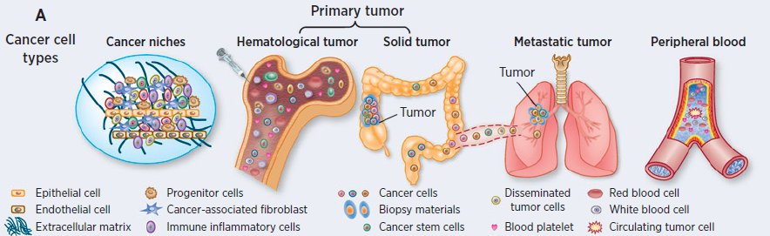
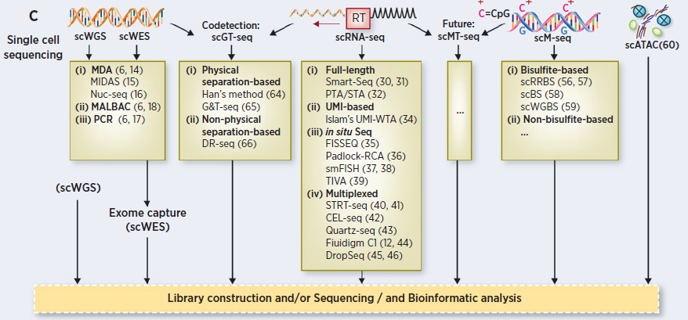
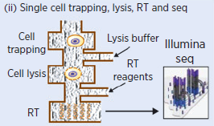
C1 microfluidics Deep sensitive profiling of cells in multiple modes
Modified from Zhang et al. Cancer Research (2016)

Slide 8
C1 complements ultrahigh-throughput methods

Slide 9
Allocation of reads towards cell number or transcript number
Cells
High-expressing genes
Transcripts
Low-expressing genes

Slide 10
Ultrahigh-throughput methods cover many cells with low-depth sequencing
Cells
High-expressing genes
Transcripts
Low-expressing genes

Slide 11
C1 provides deep full-length mRNA sequencing
Cells
High-expressing genes
Transcripts
Low-expressing genes

Slide 12
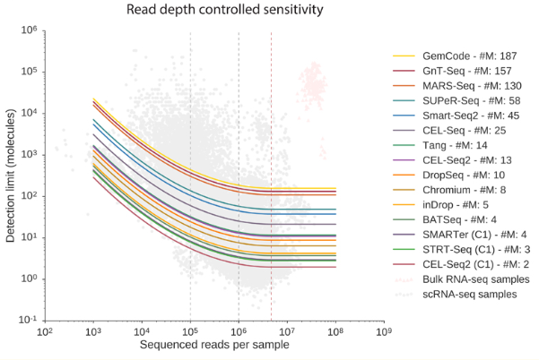
C1 methods exhibit the highest sensitivity, even when accounting for read depth
Sequencing other single-cell methods more deeply does not lead to the same gene detection as C1 methods.
More sensitivity
C1 methods
Svensson et al., Nature Methods (2017)
Notes:
This Nature Methods study by Svensson et al. evaluated 15 different single-cell protocols for accuracy and sensitivity. Not only did they demonstrate that Fluidigm C1 was more sensitive than plate-based SMART-seq2, they showed that C1 was the most sensitive of the 15 protocols tested.
This study indicates that more sequencing of droplet-based libraries would not result in increased gene sensitivity. All methods saturate in terms of gene detection. Notably, you can see that the C1 methods are most sensitive at the saturation point (about 1 million reads).
Another implication of this analysis is if one had a large sequencing budget. If they wanted both high gene number and high cell sample number (rather than the tradeoff I mentioned in the previous slides), it would make more sense to sequence more C1 samples than to sequence the droplet-based samples more deeply.
I should point out that this study was published in 2017. Therefore, some chemistries have been updated since the work was performed. For C1, the paper used SMARTer v1, while we know that SMART-seq v4 detects more genes than v1. (Of course, we know now that Total RNA-seq is even more sensitive than SMART-seq v4 as I showed in today's talk). With these updates, there's likely even greater performance of C1 over plate-based SMART-seq2. This is in addition to the advantages for using C1 of automation and reagent consistency.

Slide 13

Uncover molecular pathways with C1 Developmental biology
RESEARCH
Single-cell analysis uncovers convergence of cell identities during axolotl limb regeneration
Gerber, T., Murawala, P., Knapp, D., Masselink, W., Schuez, M., Hermann, S., Gac-Santel, M., Nowoshilow, S., Kageyama, J., Khattak, S., Currie, J.D., Camp, J.G., Tanaka, E.M., Treutlein, B.
Science (2018): 10.1126

Slide 14
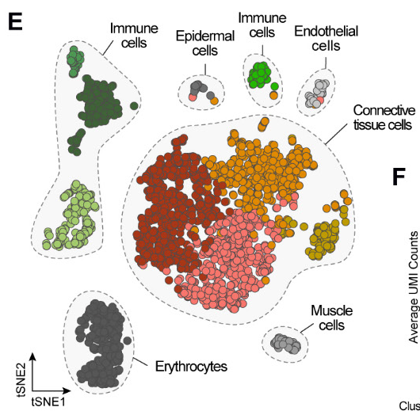
Understand cellular diversity with ultrahigh-throughput methods
10x Genomics® Chromium™ was used to sample the cellular diversity in the uninjured adult limb.
Gerber et al. (2018)
Notes:
They used 10X to understand cellular diversity in the “uninjured” limb, and defined 8 cell types with ~2400 cells.
“We used a high-throughput droplet-based scRNA-seq method (10x Genomics®) to sample the cellular diversity in the uninjured adult limb and further validate this transgenic line.”

Slide 15
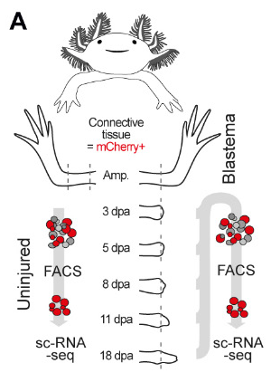
Deeper profiling with C1 to uncover molecular pathways
Fluidigm C1 was used to obtain high transcriptome coverage of mCherry+ cells and understand the molecular pathways involved in connective tissue regeneration.
(3 days post amputation, 108 cells; 5 dpa, 167 cells; 8 dpa, 121 cells; 11 dpa, 163 cells; 18 dpa, 135 cells)
Gerber et al. (2018)
Notes:
Then, they amputated the limb and used C1 at several time points to understand the active molecular pathways that were contributing to regeneration. This required higher transcriptome coverage than they could get with 10X . They looked at 6-7 time points during regen, plus ran a few cells from uninjured limbs, and needed only 100-200 cells per stage.
“To understand the molecular pathways involved in CT regeneration, we used a high transcriptome coverage scRNA-seq method (Fluidigm C1) to analyze mCherry+ cells isolated by FACS (Prrx1:Cre-ER;Caggs:lp-Cherry) along a dense time course that captures the major transitions during regeneration.”

Slide 16
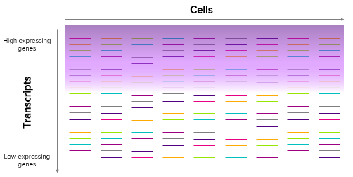
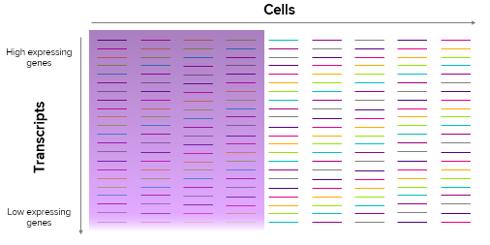
Comprehensive single-cell transcriptome analysis
Classify with ultrahigh-throughput methods such as Drop-seq or 10x Chromium with low-depth mRNA sequencing analysis to identify and atlas single cells.
Characterize with deep profiling using C1 to verify the shallow-based findings of ultrahigh-throughput methods and uncover molecular pathways.

Slide 17
C1 applications including Total RNA-Seq

Slide 18
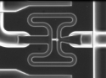
Architecture of the C1 IFC Allows chemistry flexibility
4.5 nL
9 nL
9 nL
9 nL
135 nL
135 nL
The architecture of the C1 IFC enables sensitive gene detection, full-length transcript coverage and novel chemistry development.
Notes:
What‘s attractive about the IFC is that the architecture allows for chemistry flexibility. Each capture site has several chambers associated with it where reagents can be introduced and mixed. These magenta boxes are valves, so you can introduce reagents (like a reverse transcription or PCR mix), and then mix them while undergoing thermocycling.

Slide 19
C1 offers prospects with more 30 ready-to-use applications via Script Hub™
Genomic DNA
RNA
Protein and epigenetics
Phenotype
Whole genome
sequencing [gene expression (GE)]
Full-length mRNA
sequencing (SMARTer® v1, v4; TCR-seq)
Targeted single-cell
protein analysis
Metagenomics
Whole genome
sequencing (Qiagen®)
Full-length mRNA
sequencing (Smart-seq2, TCR-seq)
Single-cell ATAC
sequencing
Cell dosing
Targeted miRNA
analysis
Whole exome
sequencing (GE)
Single-cell analysis of
genotype, expression and methylation
End counting methods:
5ʹ UMI sequencing
(C1 CAGE)
3ʹ end counting
Targeted genome
sequencing
(GE and Access Array™)
Single-cell TCR and
ATAC sequencing
Targeted mRNA analysis with real-time PCR
Low cost full-length mRNA
sequencing (NEBNext®)
Total RNA sequencing to sequence mRNA and noncoding RNAs

Slide 20
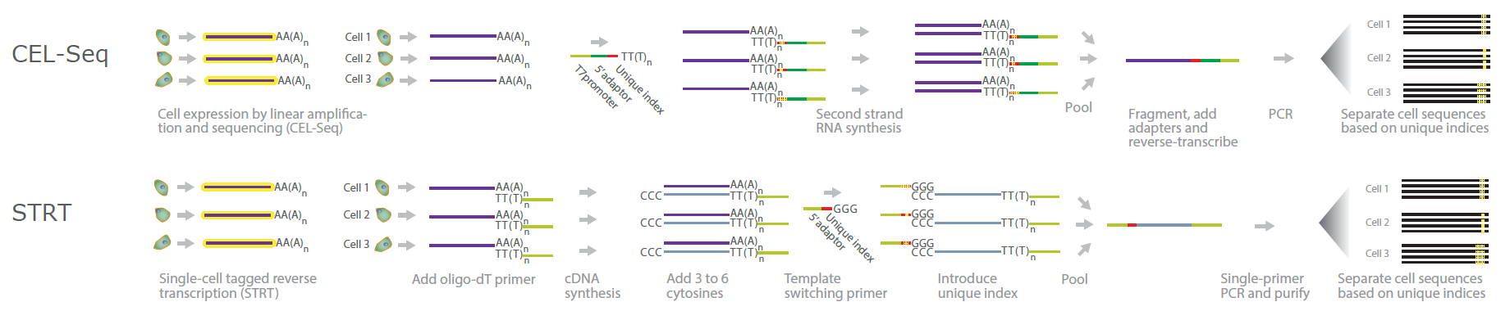
Current scRNA-seq methods target only polyadenylated RNAs with oligo-dT-based capture
Adapted version of these methods available on C1
Drop-seq
Images taken from https://www.illumina.com/science/sequencing-method-explorer.html

Slide 21
Types of nonpoly(A) RNA
mRNA
Replication-dependent histone mRNAs lack poly(A) tail.
Noncoding RNA (ncRNA)
ncRNA is not synonymous with nonpoly(A) RNA.
Some ncRNA (for example, certain lincRNAs) have poly(A) tail and can be detected by SMART-Seq® chemistry on C1*.
*Liu et al. Genome Biology (2016). “Single-cell analysis of long non-coding RNAs in the developing human neocortex.” (Used SMART-Seq chemistry on C1)

Slide 22
ncRNA biotypes
Abbreviation | Name | Function
lincRNA | Long intergenic noncoding RNA | Gene regulation, splicing, translation
eRNA | Enhancer RNA | Gene regulation
snRNA | Small nuclear RNA | Splicing
snoRNA | Small nucleolar RNA | Splicing, translation
miRNA | MicroRNA | Translation
rRNA | Ribosomal RNA | Translation
tRNA | Transfer RNA | Translation
tmRNA | Transfer-messenger RNA | Translation
Enabling study of these ncRNA biotypes at the single-cell level will allow for a more comprehensive understanding of cellular mechanisms.

Slide 23
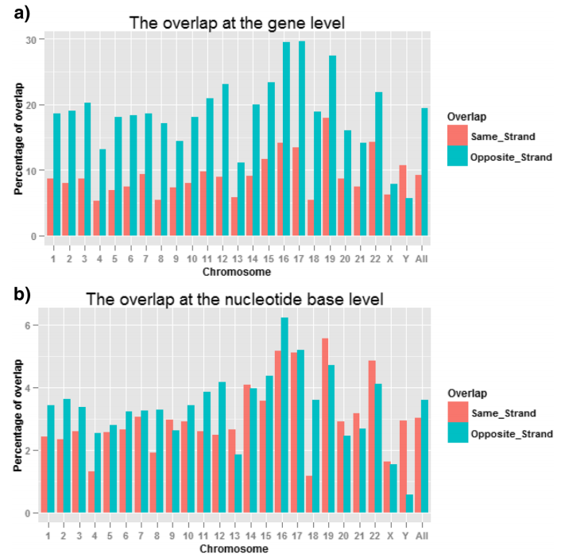
Stranded libraries improve accuracy
Around 19% (11,000) of genes overlap with one or more genes on the opposite strand.
Those regions translate to about 3% of overlapping nucleotides.
Without strand information, reads are either wrongly assigned (false positive) or discarded (false negative).
Zhao et al. BMC Genomics (2015). “Comparison of stranded and non-stranded RNA-seq transcriptome profiling and investigation of gene overlap.”

Slide 24
Adapting Stranded Total RNA Seq for C1

Slide 25
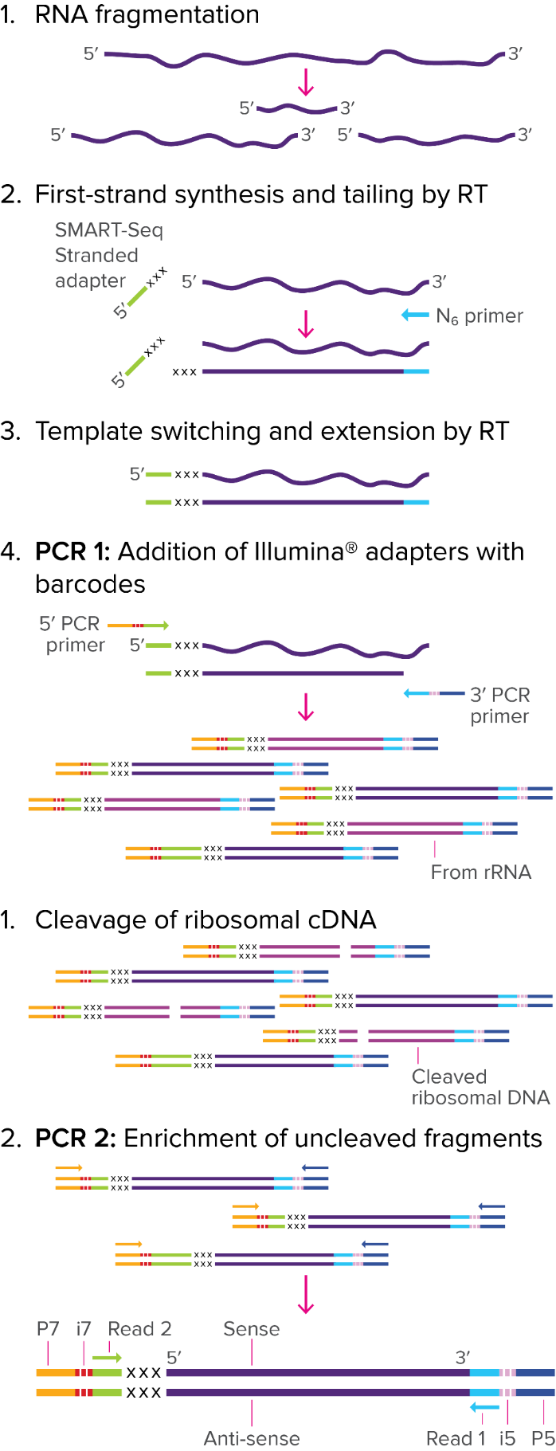
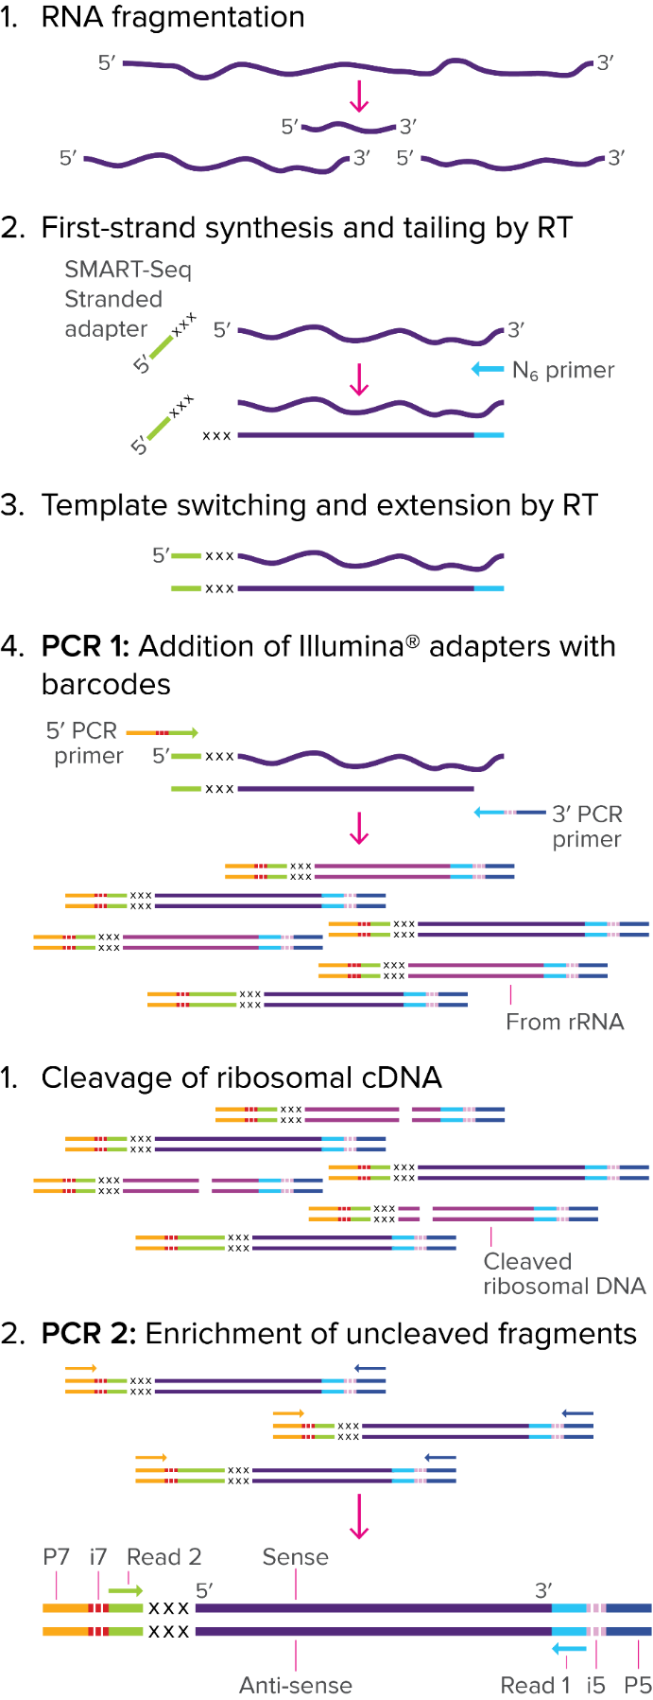
Stranded Total RNA-Seq workflow
Automated steps on C1
Single-tube library prep after C1
Adaption of SMART-Seq Stranded Kit (Takara Bio)

Slide 26
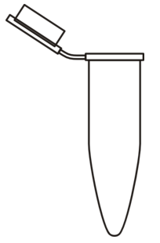
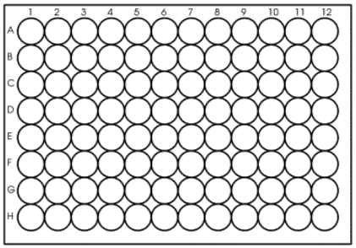
Benefits Workflow and cost
 | Total RNA-Seq | SMART-Seq v4
On-IFC amplification | Back-loading indexing PCR | Universal amplification
Post-C1 workflow | No extra kit needed Samples pooled after harvest rRNA depletion and final PCR performed in a single tube | Nextera® XT, index kits required Samples pooled after final PCR Tagmentation through indexing PCR performed in 96-well plate
Third-party kit cost | Chemistry: $4,320 (15 IFCs) Cost per IFC: $688 Total cost per IFC: $688 Library prep: $0 Cost per cell: $7.16 | Chemistry: $2,688 (10 IFCs) Cost per IFC: $1,075.00 Library prep: $550 Total cost per IFC: $1,625.00 Cost per cell: $16.92
C1 Total RNA Seq provides an easier and much cheaper workflow without compromising biological data.

Slide 27
Total RNA-Seq performance

Slide 28
Development objectives
Assess the performance of C1 Total RNA-Seq application on multiple cell types.
Evaluate the efficiency of Total RNA Seq in comparison to a poly(A)-based method.
Experiments were performed side by side with the SMART-Seq v4 Ultra® Low Input RNA Kit.
Employed an analysis pipeline for stranded single-cell total RNA-seq data.

Slide 29
Experimental design
 | K562 Cells | HL-60 Cells | Activated T Cells
Cell description | Myelogenous leukemia cell line, robust cell type | Leukemia cell line, fragile cell type | Primary cell, stimulated with anti CD3/CD28 beads
IFC size | Medium | Small | Medium
Total RNA-Seq | 3 IFCs* | 3 IFCs* | 2 IFCs
SMART-Seq v4 | 2 IFCs | 2 IFCs | 2 IFCs
* Initial TR experiments with K562 and HL-60 cells were run with the SMARTer Stranded Total RNA-Seq Kit v2 – Pico Input Mammalian. The remaining Total RNA Seq experiments were performed using the updated SMART-Seq Stranded Kit after its launch in May 2018.

Slide 30
Bioinformatic analysis workflow
Raw sequencing data from
MiSeq™ v3 150-cycle kit
(FASTQ files)
Ensembl hg38 CDNA reference (release 92)
(FASTA file)
(kallisto index)
Kallisto index
(T-DBG)
(kallisto quant;
stranded mode for TR)
Ensembl hg38 ncRNA reference (release 92)
(FASTA file)
abundance.h5
abundance.tsv
run_info.json
Generate gene-level expression tables
(tximport)
Generate metrics
(custom Python and R scripts)
Batch correction of expression table
(Seurat linear regression)
Sequencing metric visualizations
Hypothesized gene expression
Biotype proportions
Dimensional reduction
(custom Python and R scripts, Seurat)
FASTQ files were also processed to visualize transcript coverage
(Bowtie, Picard)

Slide 31
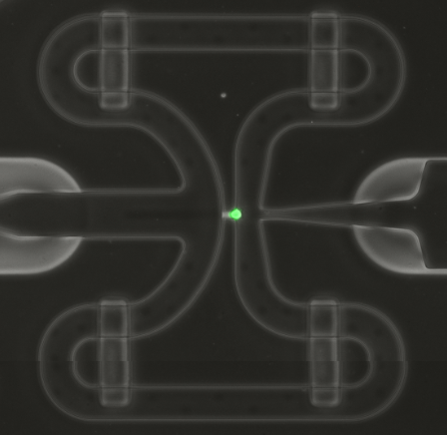
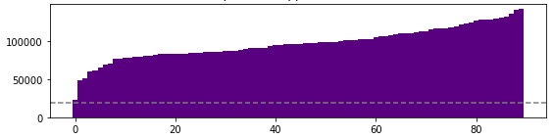
Processing live cells Only cells with >20,000 mapped reads received secondary analysis
Single live cells, sorted
Mapped reads
Single live cell
One IFC shown as an example. Dashed line indicates 20,000 mapped reads.
 | K562 | HL-60 | Activated T Cells
SMART-Seq v4 | 57 90 | 40 42 | 38 24
Total RNA Seq | 58 83 76 | 69 45 65 | 38 40
A total of 765 cells passed filters for further analysis.
For K562 and HL-60, two IFCs each were run with an older version of Total RNA Seq chemistry before the current version was launched.

Slide 32
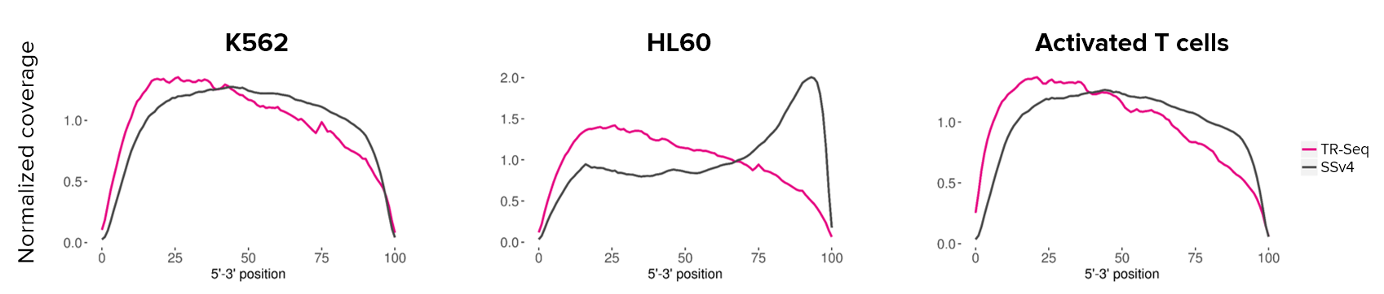
Total RNA-Seq shows similar or better transcript coverage than SMART-Seq v4
HL-60
Total RNA Seq provides better coverage across transcripts in cell types that show high 3’ bias in SMART-Seq v4 chemistry.
Notes:
Document reference, etc.

Slide 33
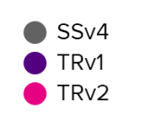
Total RNA-Seq Shows higher gene detection with increasing mapped reads
HL-60
Gene counted if TPM >1
Total RNA Seq demonstrates a deeper cell characterization methodology aiding full single-cell transcriptome analysis.
Notes:
K562 cells approach 9-10,000 genes with the latest TR chemistry.
HL60 cells are at about 6,000 genes. We know that HL60 has a lower RNA content so it makes sense that it would have a lower number of genes.
Activated T cells approach 8-9,000 genes.

Slide 34
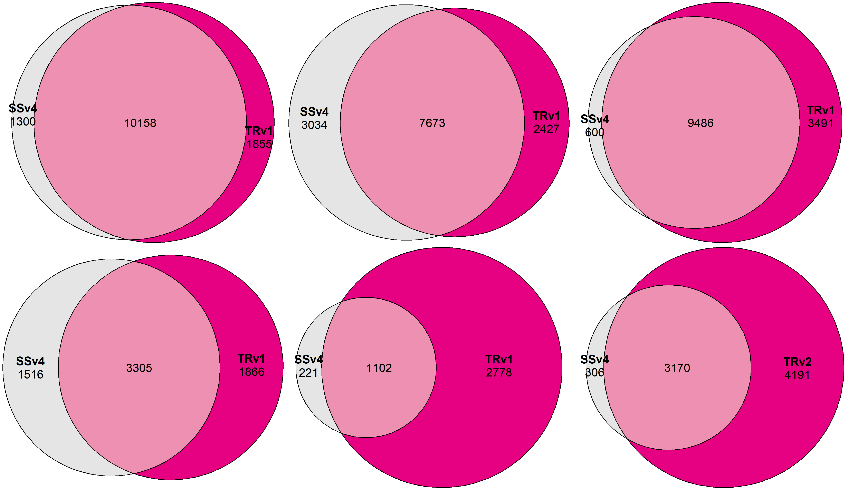




Total RNA-Seq Detects most of the same genes that SMART-Seq v4 detects
K562
HL-60
Activated T cells
Genes expressed in >10% of samples
SSv4: SMART-Seq v4
TRv1: Total RNA Seq
Genes expressed in >50% of samples

Slide 35
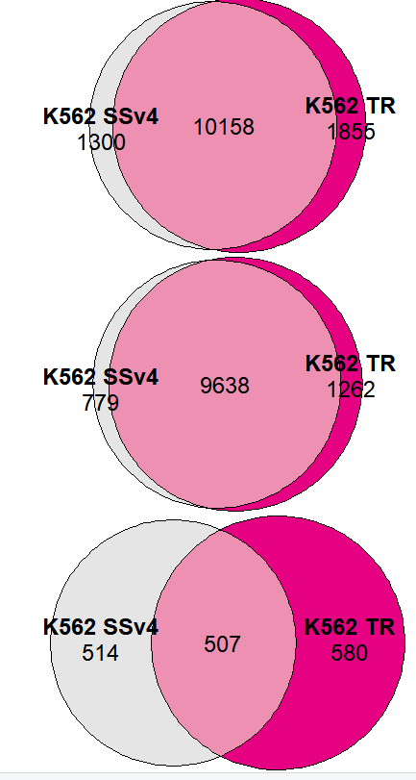
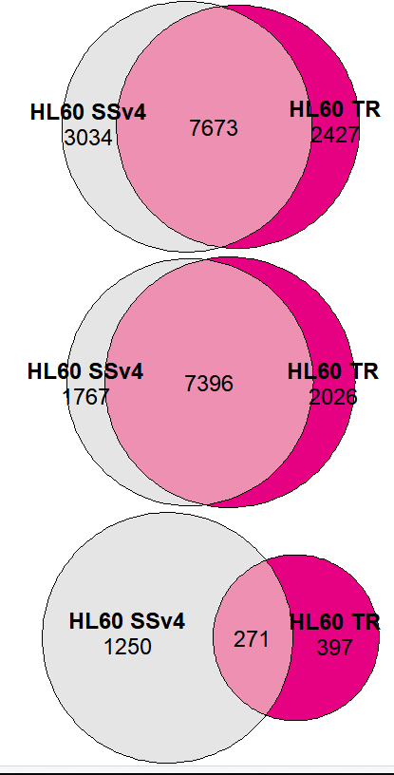
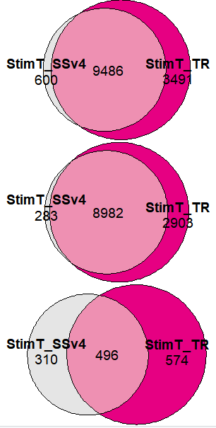
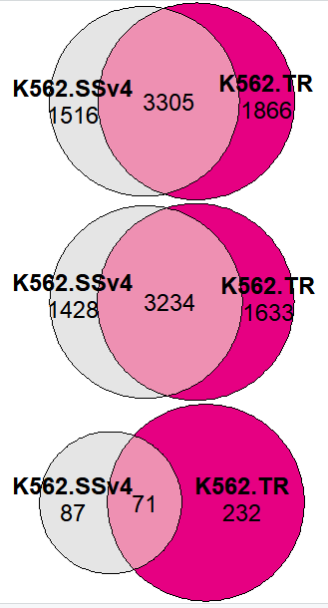
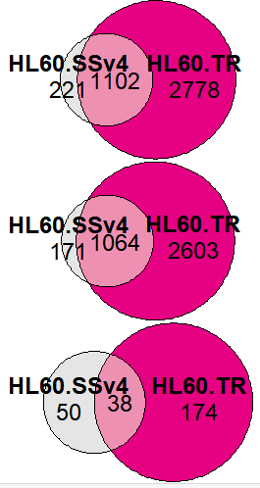
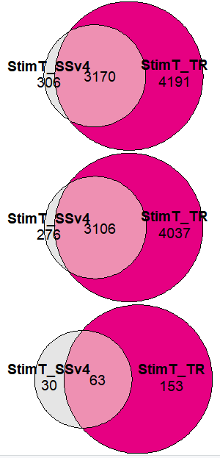
Method comparison in detection of coding and noncoding genes
K562
HL-60
Activated T cells
Coding
Genes expressed in >10% of samples
Noncoding
SSv4: SMART-Seq v4
TRv1: Total RNA Seq
Coding
Genes expressed in >50% of samples
Noncoding

Slide 36
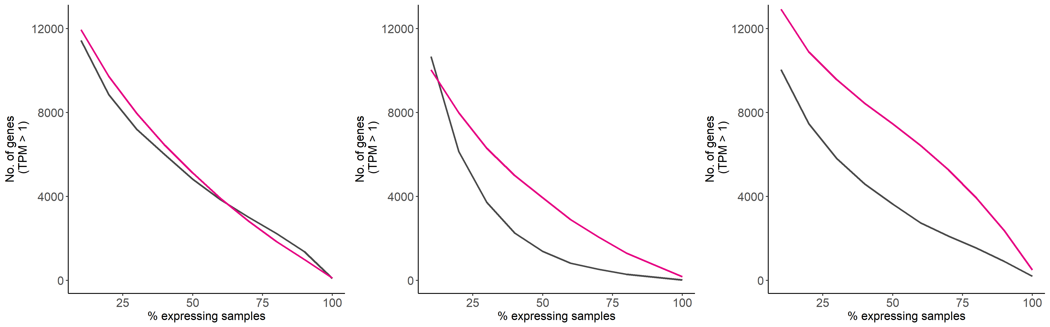
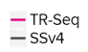
Total RNA-Seq Shows gene expression similar to or more consistent than SSv4
K562
HL-60
Activated T cells
Within a cell type, Total RNA Seq detects genes with greater consistency across samples than SMART-Seq v4.
Notes:
This analysis complements the venn diagram slides. This highlights the consistency of gene detection with TRS expression.

Slide 37
Total RNA-Seq Shows greater resolution when visualized by PCA
Total RNA Seq samples
SMART-Seq v4 samples
K562
HL-60
HL60
Activated T cells
Cells that show more variability with SMART-Seq v4 exhibit tighter grouping with Total RNA-Seq chemistry.
PCA generated with Seurat
Notes:
Note how the more fragile cell type (HL60) is “noisier” with SSv4 whereas TR is able to generate a more tighter cluster.

Slide 38
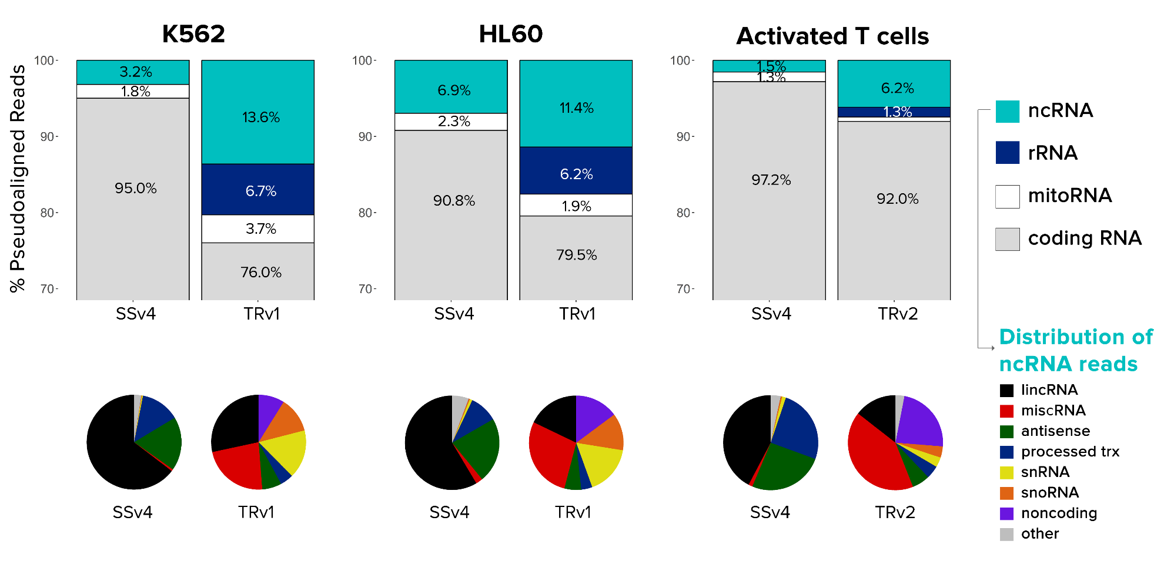
Total RNA-Seq Exhibits a greater detection of noncoding RNA
% pseudoaligned reads
Total RNA Seq detects more ncRNA and a greater diversity of noncoding RNA biotypes.

Slide 39
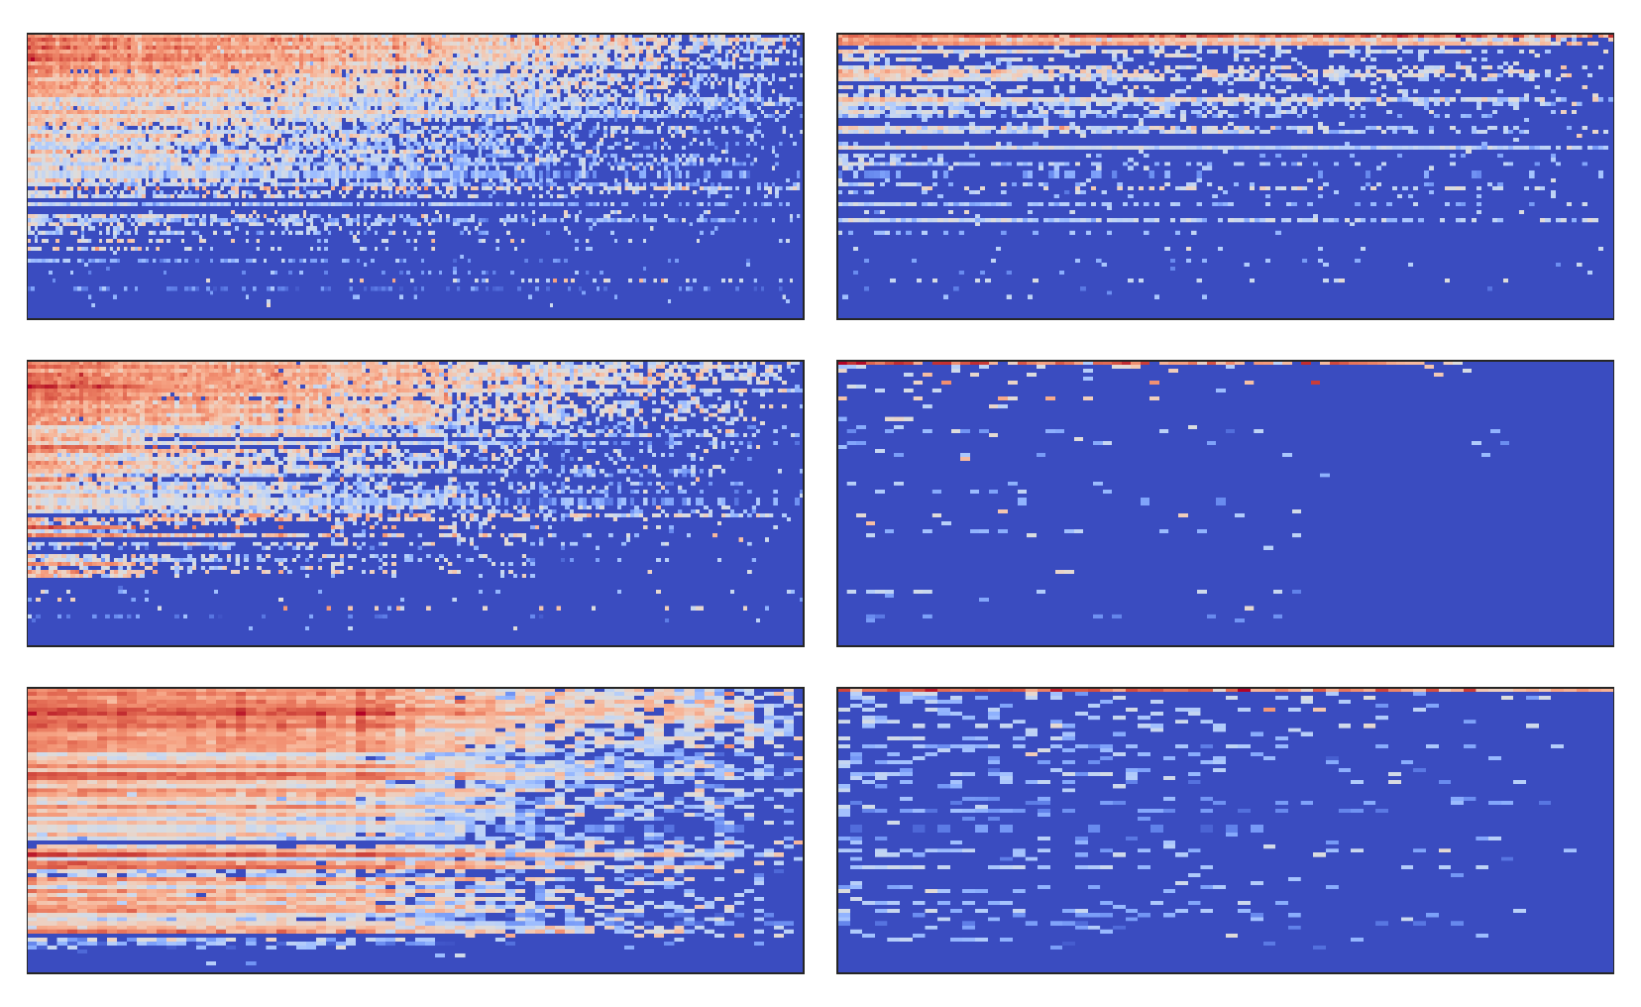
Total RNA Seq Detects more non poly(A) histone genes than SMART-Seq v4
Total RNA Seq single cells
SMART-Seq v4 single cells
K562
Histone genes
HL-60
Histone genes
Activated T cells
Histone genes
Total RNA Seq shows greater detection of histone genes, a nonpoly(A) mRNA.
71 histone genes
Notes:
Note how with SSv4 that there is lower detection of histones in HL60 as you would expect since it has less RNA. But with TR you almost see equivalent histone detection with K562, again highlighting how TR can get good signatures from “fragile” cell types.

Slide 40
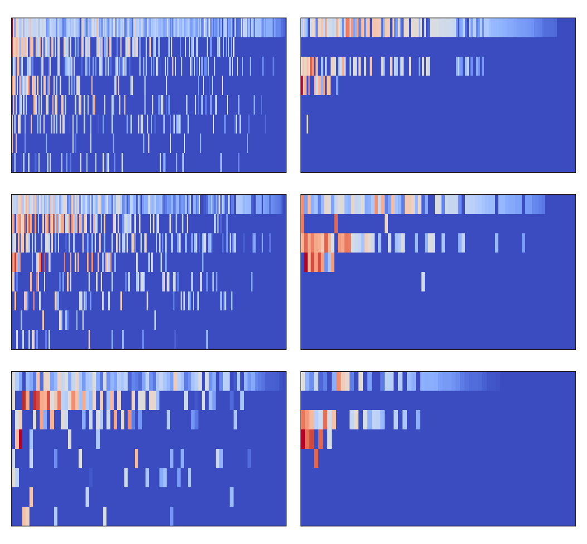
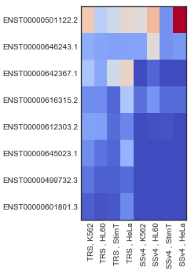
Total RNA Seq Detects more nonpoly(A), Neat1 isoforms than SMART-Seq v4
Average expression
Total RNA Seq single cells
SMART-Seq v4 single cells
TRS
SSv4
(length) Neat1 isoform
K562
(22,743)
(2994)
(1,145)
(512)
(1,053)
(3,300)
(3,441)
(3,524)
log2(TPM+1)
4
0
HL-60
Activated T cells
Neat1 = nuclear-enriched abundant transcript 1
Total RNA Seq shows greater detection in the isoforms of a nonpoly(A), noncoding RNA.

Slide 41
Conclusion

Slide 42
Total RNA-Seq methods can detect full-length nonpoly(A) isoforms
Method | Read Depth | Transcript Coverage | Poly(A) Transcript Isoforms | Nonpoly(A) Transcript Isoforms
Droplet-based methods | Low | 3′ only | No | No
C1 high-throughput | Medium | 3′ only | No | No
C1 96 (SMART-Seq v4) | High | Full-length | Yes | No
C1 96 Total RNA Seq | High | Full-length | Yes | Yes

Slide 43
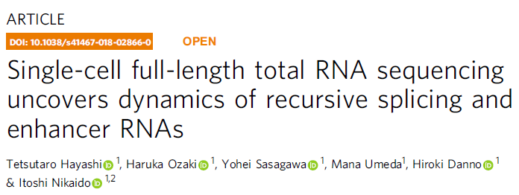
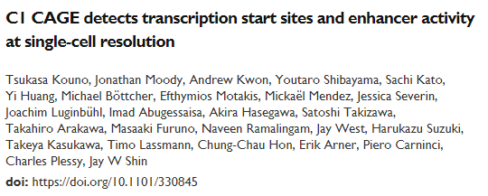


Methods for ncRNA and nonpoly(A) RNA produced with C1
Hayashi et al.
Nature Communications
February 2018
Kouno et al.
BioRxiv, May 2018
Launched on Script Hub May 2016
Fluidigm Total RNA Seq
Launched on Script Hub September 2018
Verboom et al.
BioRxiv, September 2018
Notes:
The Shin/Plessy also at RIKEN have used C1 cage to do 5’ end counting for ncRNA.

Slide 44
Total RNA Seq Summary
C1 IFC architecture enables myriad applications including Total RNA Seq.
Provides one of very few methods to sequence both poly(A) and nonpoly(A) RNAs in single cells
Simpler workflow than most protocols, enabling on-IFC indexing PCR and single-tube post-C1 prep
Maintains full-length coverage with little 5′−3′ bias in cell types where SMART-Seq v4 shows a strong 3ʹ bias
Provides a method for researchers to perform deeper single-cell characterization by enabling analysis of novel non-coding RNA features

Slide 45
For Research Use Only. Not for use in diagnostic procedures.
©2018 Fluidigm Corporation. All rights reserved. Fluidigm, the Fluidigm logo, Access Array, Biomark, C1, Polaris and Script Hub are trademarks and/or registered trademarks of Fluidigm Corporation in the United States and/or other countries. All other trademarks are the property of their respective owners. 11/2018

